Slide 1
Linear Data Structures
Static List (Array), Linked List, Double Linked List, Stack, Queue

Slide 2
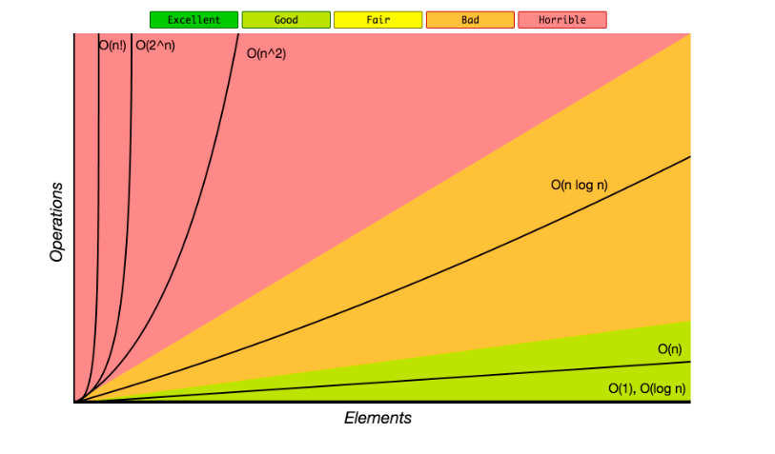
What is complexity?

Slide 3
Array List
Functions :
Add
Remove
Get At Index

Slide 4
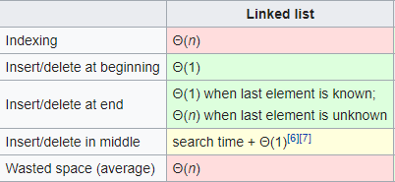
Linked List
Functions :
Add
Remove
Get At Index

Slide 5
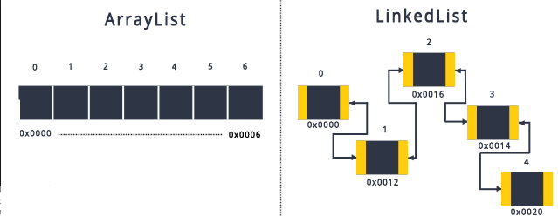
Array List vs Linked List

Slide 6
Double Linked List
What’s the difference between single linked and double linked list ?

Slide 7
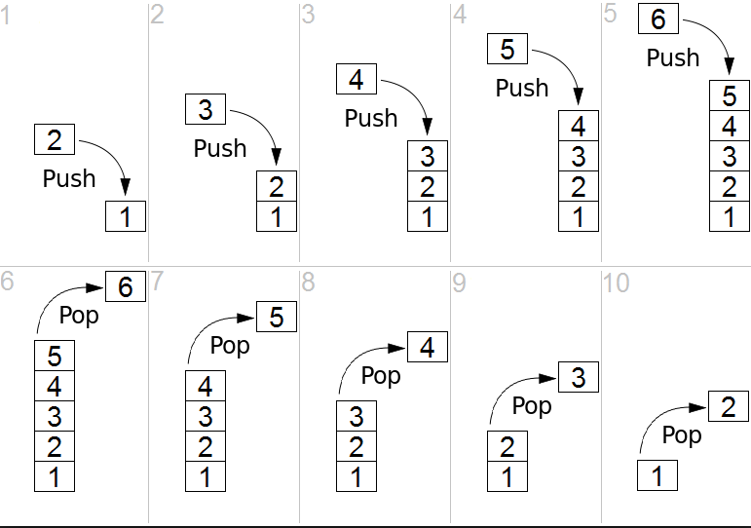
Stack
Functions :
Push
Pop
Top/Peek

Slide 8
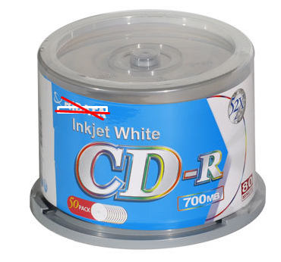

Slide 9
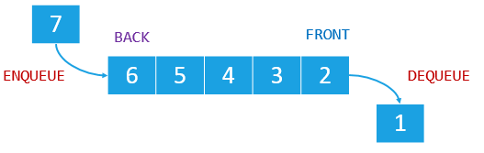
Queue
Functions :
Enqueue
Dequeue
Front
Back

Slide 10
Questions

